Slide 1

Global Sugar Intake Analysis
CAITLaN Beachey, Amaris hassan, Cecilia leung, Hillary mandich, kapil pundhir
Notes:
Good evening everyone, today I will be presenting to you my team’s (introduce team) analysis of sugar intake across the world.

Slide 2
PRESENTATION GUIDELINES
Core Message
Define the Project
Data Exploration
Data Cleanup
Data Analysis
Challenges
Conclusion
Next Steps
Q&A.
Notes:
Throughout this presentation, I will explain to you:
-The motivation behind the project and why we thought this was a topic of value.
-The questions we sought to answer.
-As well, I will discuss the process used to explore, cleanup, and analyze the data.
-Our findings and next steps of this project we’d like to see moving forward.

Slide 3

CORE MESSAGE
“Everything is Cake!”
~ Article source: Global News
This article raised the question as to the global average daily sugar consumption and it’s impact on our health.
Notes:
-In September of this year, the Irish Supreme Court ruled that Subway bread would be better categorized as a ‘discretionary indulgence’.
-This means it was better classified with food items such as ice-cream, cake, chocolate, and pastries.
-Keep in mind, the American Heart Association recommends an 37.5 g for adult males and 25 g for adult women. With a footlong sub, coming in at 10 g (30-50% of your daily take)… we wanted to explore exactly how much sugar is being consumed globally and whether it’s had an impact to our health over the years.
-Fun Fact: Subway bread sugar content is 10% of the weight of the flour included in the dough.

Slide 4
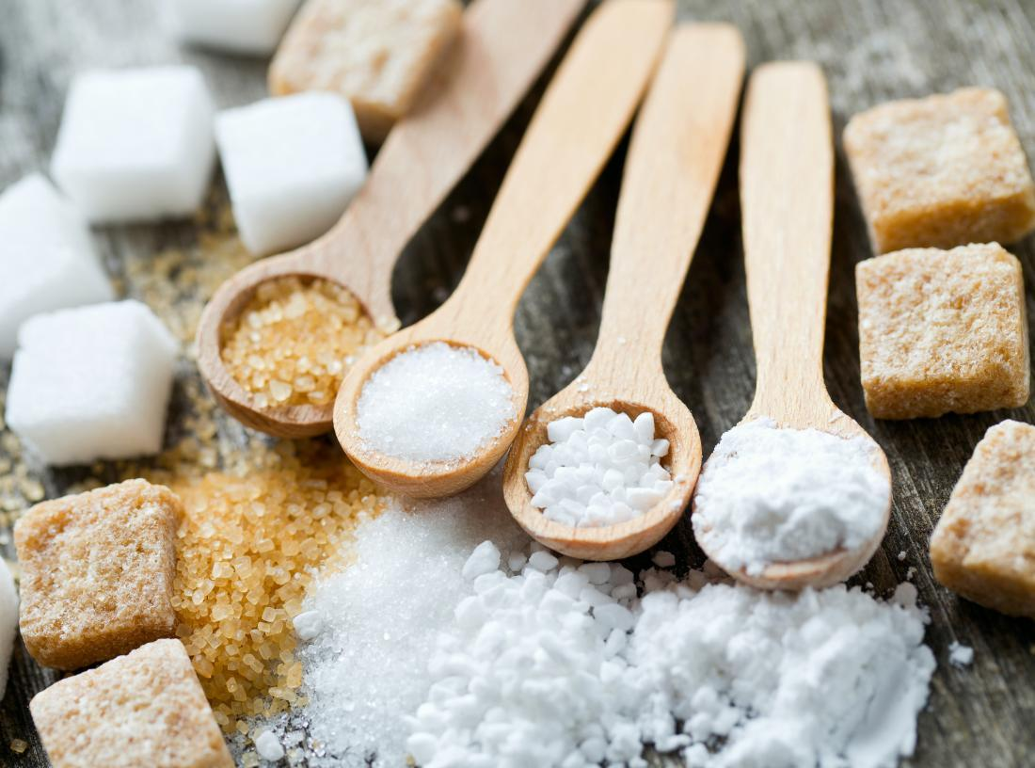
DEFINE THE PROJECT
What is the average daily intake sugar of countries across the world? Which countries consume the most on average?
How has the average sugar intake changed over time?
What is the correlation between income and sugar intake?
Is there a correlation between sugar intake and obesity?
Is there a correlation between sugar intake and dental health?
What are the top 5 purchased grocery items? For these 5 top items, what is their sugar content?
Notes:
It should be noted that our project reviewed sugar content for both naturally occurring sugars and free sugars added to foods and drinks by the manufacturer.

Slide 5

SUMMARY OF FINDINGS
There has been an increase in global sugar consumption over time
The United States has been well above the global average
For 2011 – 2013, the United States had the highest sugar intake globally
American grocery data indicates that soda is one of the top 5 purchased items
Countries will higher average household income has a higher sugar intake.
The higher the sugar intake, the higher the obesity rate.
Notes:
Global Average years has been: 83.6 g (2011), 84.1 g (2012), 84.2 g (2013)
The United States Average: 172 g (2011), 174 g (2012), 175 (2013)
According to our data, soda contains X sugar per gram.
Were you able to answer these questions to your statisfaction? Wish we had a more recent data set for average sugar consumption.
This created limitations when analyzing other data for health effects and income.

Slide 6

DATA EXPLORATION
FAO
Kaggle
Kroger Grocery Data
Fat Secret API
Datasets
WHO
World-bank
Notes:
Compare the sugar intake for all countries in the world.
Compared the impact of income on average sugar intake: World Bank Data
For Dental Health and Obesity comparisons, using
For top purchases grocery store data, we used Kroger Grocery Data set. Next, we used the Fat Secrets API to find and compare their sugar content.
Discuss insights you had while exploring the data that you didn't anticipate:
Standardarized data was hard to come by as there are no set recommendations.
Time consuming to research the right data for our analysis
Not all countries have the ability to research and collect data on sugar consumption.
Not all information for a specific country may not be available as some of the countries were not independent until 1990-1993
6. Discuss any problems that arose after exploring the data, and how you resolved them:
Data was hard to retrieve as the sugar content was deeply embedded
Converting data types to conduct analysis
Reformatting CSV files in proper rows and columns, merging data frames to determine trends and correlation??

Slide 7

DATA CLEANUP – INSIGHTS AND DIFFICULTIES
Requires team effort to brainstorm on where to get the data
Time consuming to research the right data for our analysis
Not all information for a specific country may not be available as some of the countries were not independent until 1990-1993
Formats of the Datasets
Requires reformatting CSV files in proper rows and columns
Merging data frames to determine trends and correlation
Complexity of API
Data was hard to retrieve as the sugar content was deeply embedded
Converting data types to conduct analysis

Slide 8

DATA ANALYSIS

Slide 9
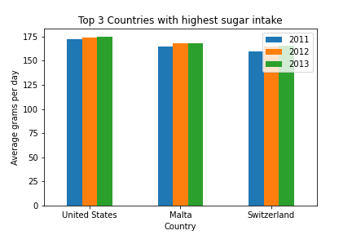
What IS the average daily sugar intake and which countries have the highest sugar consumption?
Results:
USA
Malta
Switzerland
Import Average Sugar Intake csv dataset in Jupyter Notebook and create a data frame.
Filter data to 3 years and sort by descending order for average gram to get countries with highest consumption.
Used Matplotlib method to get bar graphs of the countries with the highest consumption.

Slide 10
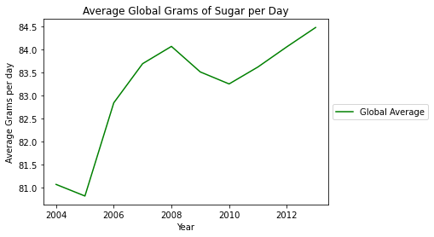
HOW HAS THE AVERAGE SUGAR INTAKE CHANGED OVERTIME?
The trend shows an increase of sugar intake over the past 10 years.
Import Average Sugar Intake csv dataset in Jupyter Notebook and create a data frame.
Filter data for 10 years and calculate the mean of sugar intake to get the Global Average
Used Matplotlib method to get a line graph to show the trend over the years.

Slide 11
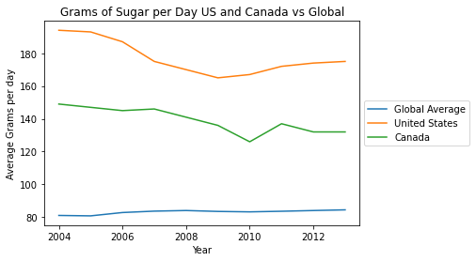
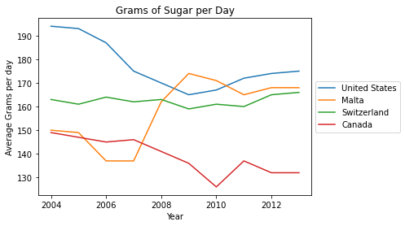
Where do Canadians stand?
Canada trends above the world average FOR SUGAR CONSUMPTION.
Notes:
-World Average – fluctuates between 81 g– 84 g from 2004 – 2013.
-Canada Average – 149 g– 132g (small reduction of sugar intake from 2004 – 2013). Still well above the global average.
FYI:
-Malta – 150 g to 170 g
-Switzerland – 160 g to 166 g
-United States – 194 g to 175 g (similar trend to Canada, still highest intake).

Slide 12
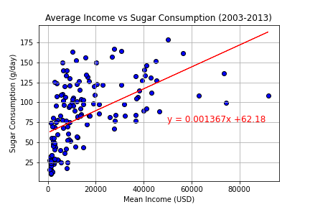
CORRELATION BETWEEN INCOME AND SUGAR INTAKE
Moderately Positive Correlation of 0.54
Sugar consumption increases as average household income increases across the world.
Imported the Sugar Intake and Income CSV files.
Conducted an inner merge for the two files together to get all the data in 1 Data Frame.
Did an average of the income over the years between 2002-2013.
Used the Matplotlib method to get the scatterplot and linear regression model to determine if the two factors are correlated.

Slide 13
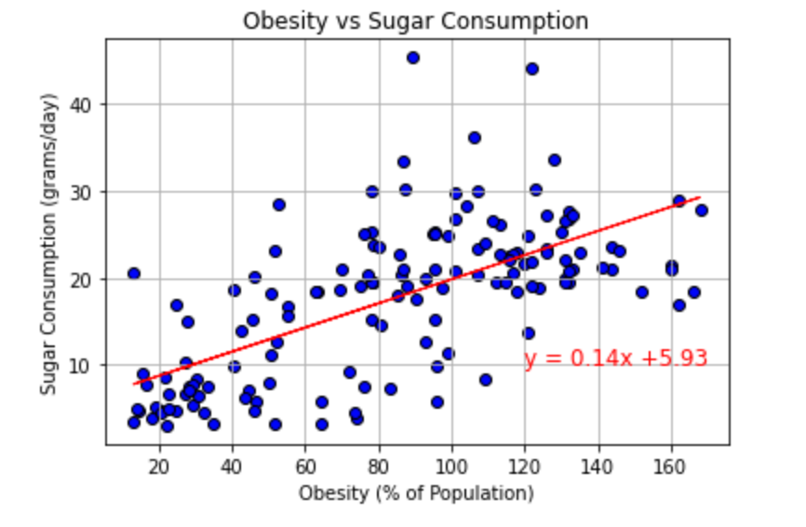
CORRELATION BETWEEN SUGAR INTAKE AND OBESITY
Moderately Positive Correlation of 0.66
For most cases, obesity rate increases as sugar consumption increases.
Imported the Sugar Intake and Obesity CSV files.
Conducted an inner merge for the two files together to get all the data in 1 Data Frame.
Did an average of the income over the years between 2002-2013.
Used the Matplotlib method to get the scatterplot and linear regression model to determine if the two factors are correlated.

Slide 14
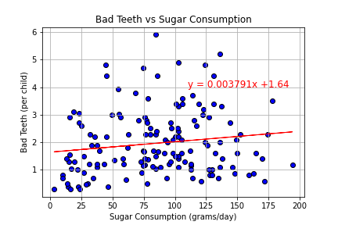
CORRELATION BETWEEN SUGAR INTAKE AND DENTAL HEALTH
Very weak correlation of 0.14
Sugar intake does not impact the dental health of the population.
Imported the Sugar Intake and Bad Teeth CSV files.
Conducted an inner merge for the two files together to get all the data in 1 Data Frame.
Validated the data and ensure there enough samples to do a Scatterplot.
Used the Matplotlib method to get the scatterplot and linear regression model to determine if the two factors are correlated.

Slide 15
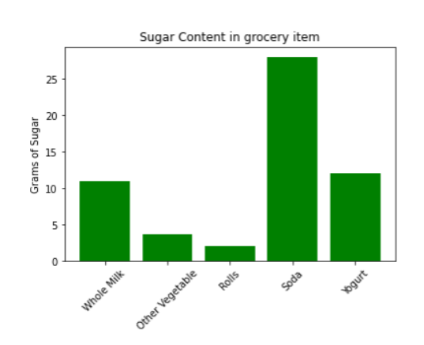
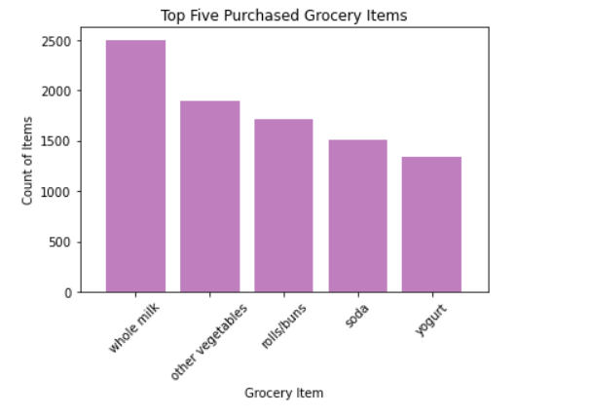
WHAT ARE THE TOP 5 PURCHASED GROCERY ITEMS IN THE COUNTRY WITH THE HIGHEST SUGAR INTAKE?
Whole Milk
Vegetables
Rolls/Buns
Yogurt
Soda
Imported the Grocery data CSV files.
Groupby Item List to get a count of the most purchased product.
Validated the data to ensure the data is accurate.
Used the Matplotlib method to get the bar graph.
Pulled the API from Fat Secret to get the sugar contents of the products.
API was reviewed and generic product were chosen for each item.
Notes:
Soda size = 1 can
Soda has the highest sugar content of X grams.

Slide 16

CONCLUSIONS
Expected Results:
Increase intake in sugar consumption over the last decade
Higher income households consume more sugar
High sugar consumption can lead to health impacts like obesity
US is the country with the highest sugar consumption around the world
Unexpected Results:
Bad dental health is not correlated to sugar intake
Malta and Switzerland are in the top 3 of countries with high sugar consumption
Notes:
- Change in accessibility to foods globally. Increase in globalization and world trade.
Unhealthy items are lower priced than healthy/organic products.
Households with higher income can afford to eat out and indulge more.

Slide 17

CHALLENGES
Data Collection
Difficulties finding recent data and dataset within the same year
Used more outdated sets then we would have liked
API
No standardization with nutrition labels
Inconsistent data types
Choosing a product that represent a grocery category
Notes:
Difficulties – API → Kapil to fill in
Focusing on the Questions
Sugar intake is a broad topic
We narrowed down to the specific factors to look for the information

Slide 18

ADDITIONAL RESEARCH
High Sugar Intake on more Diseases
Sugar Intake by Demographics
Accessibility’s Impact on Sugar Intake
Legislation Impact on Sugar Intake
Notes:
Questions – How it has impacts on other disease, how it relates to age, does having a healthy lifestyle affect it?

Slide 19


